Slide 1

KALA VIDYALAYA HIGH SCHOOL. MALWANI , MALAD MUMBAI-400095
PRIMARY SECTION

Slide 2
OUR VISION
Our vision is for each child to develop a curiosity of learning, discover their interests and grow in their love of learning. We also desire to have strong families through parent support/fellowship and skills training.

Slide 3
OUR GOAL
Our goal is to support and nurture the children's and our own natural desire to be life-long learners. We are committed to the families we serve, providing support and encouragement.

Slide 4
FOCAL POINTS
SPACIOUS CLASSROOMS
WELL TRAINED TEACHERS
ONLINE / OFFLINE LECTURES
ORIENTATION PROGRAMS
LABORATORY
PLAYGROUND AND SPORTS
EXTRA CURRICULAR ACTIVITES

Slide 5
PTM

Slide 6
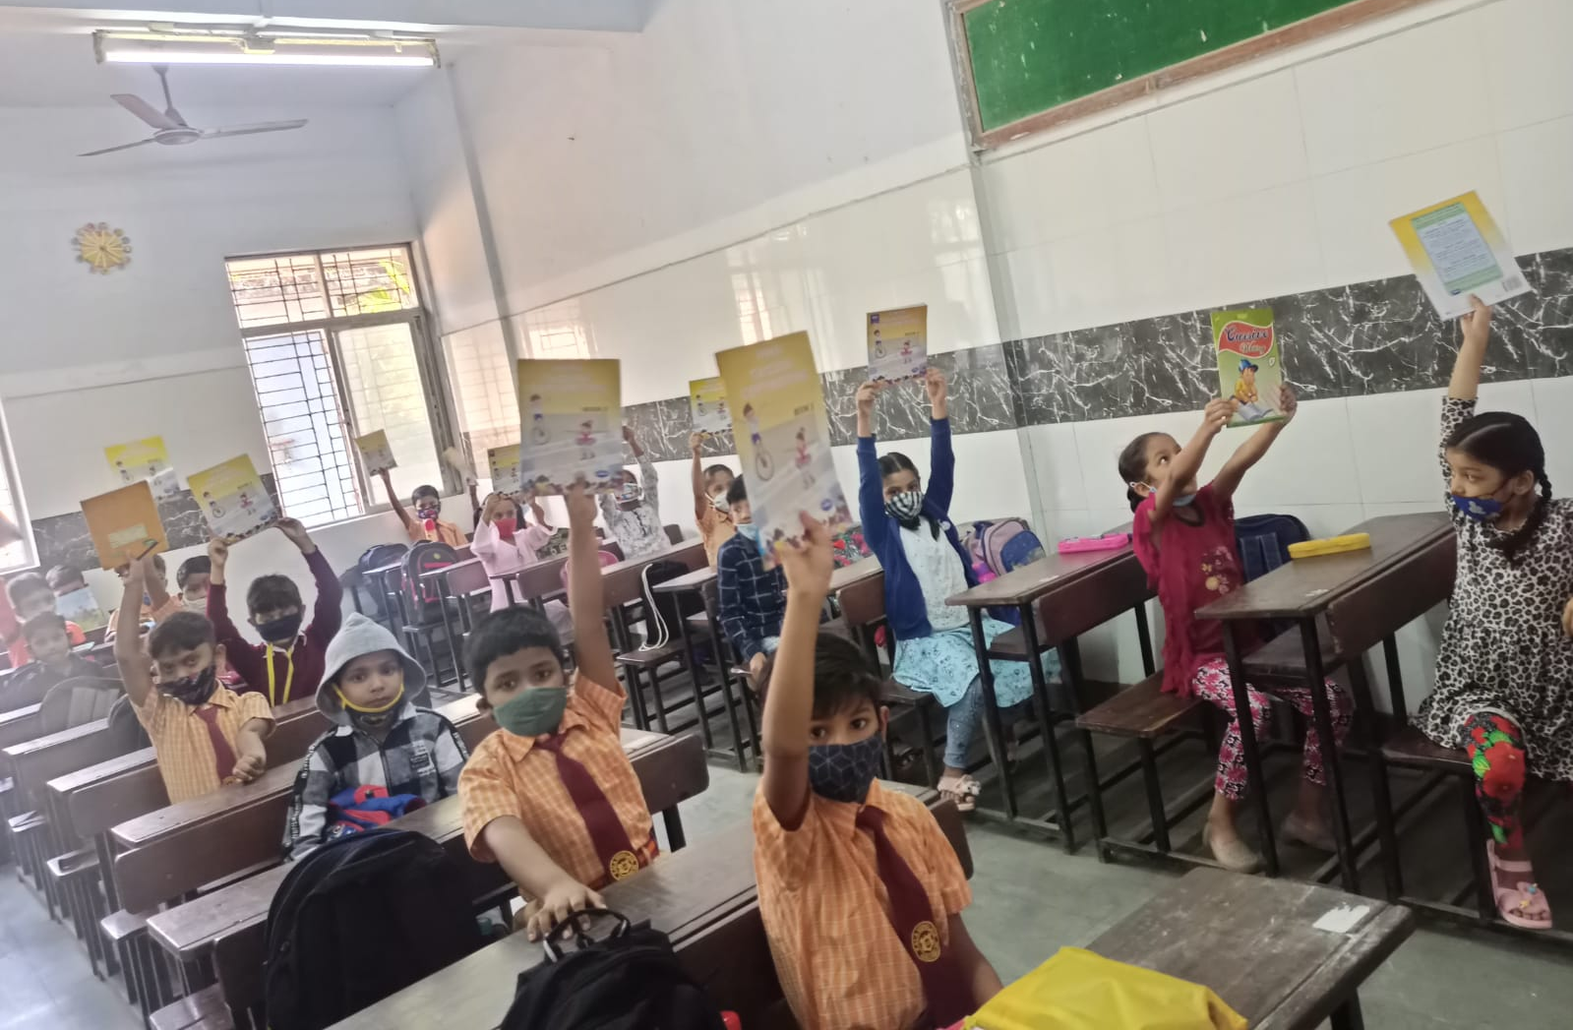
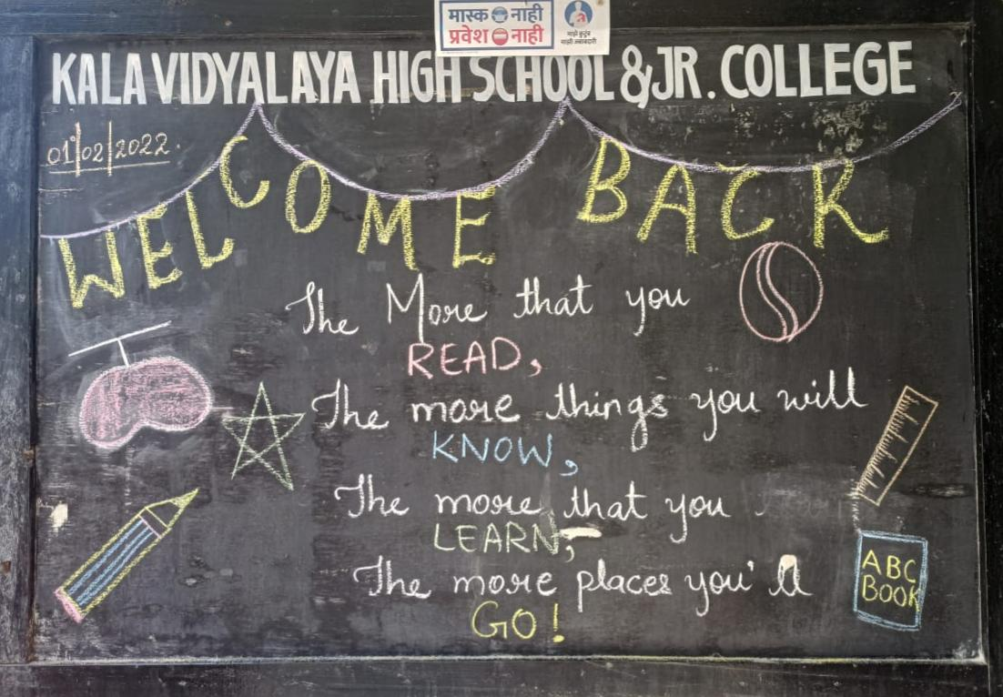
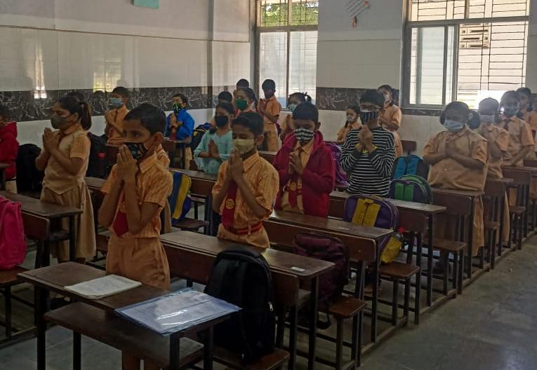
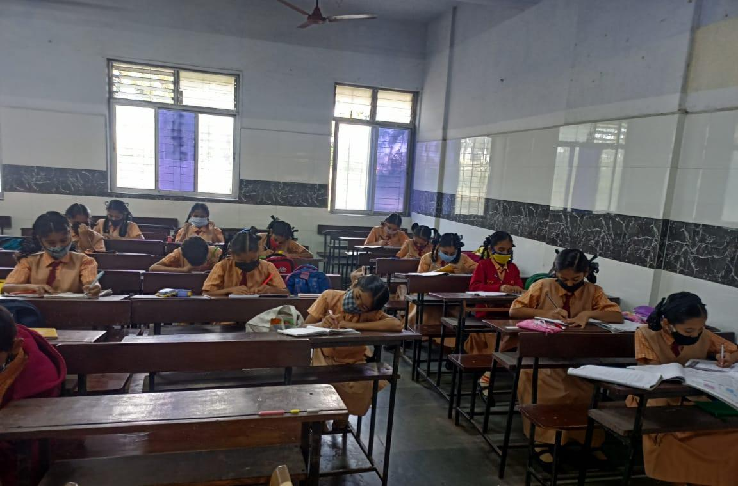
OFFLINE LECTURES

Slide 7
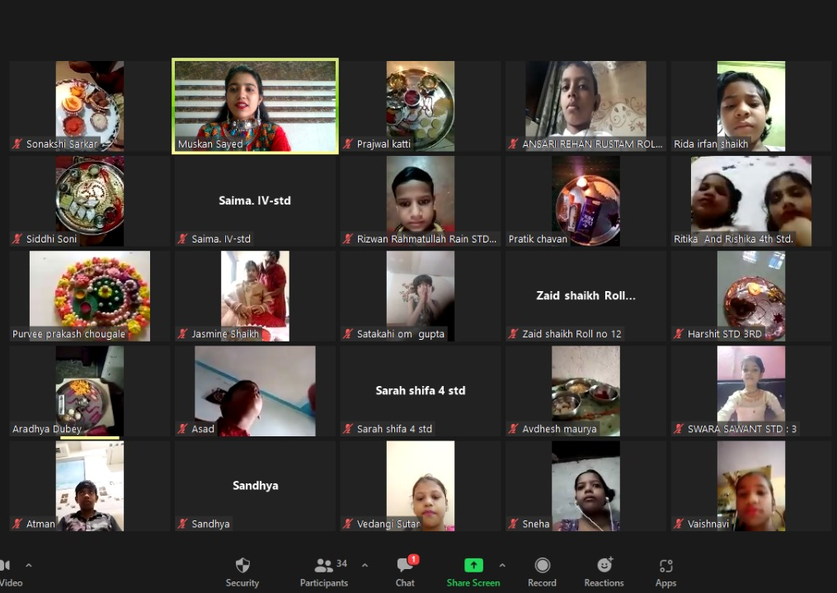
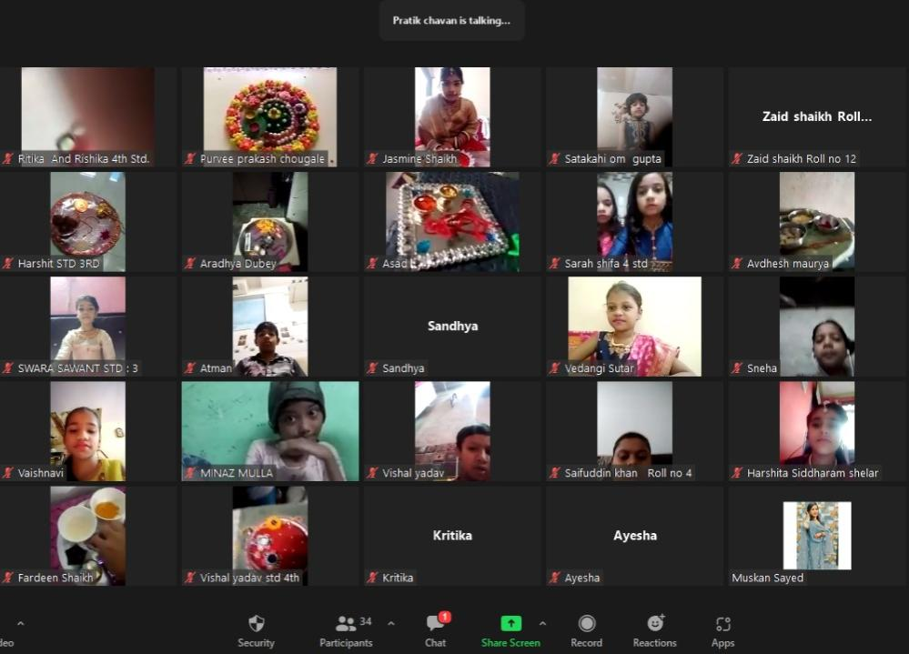
RAKSHA BANDHAN ONLINE ACTIVITY

Slide 8
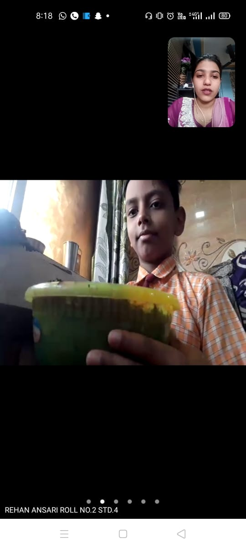
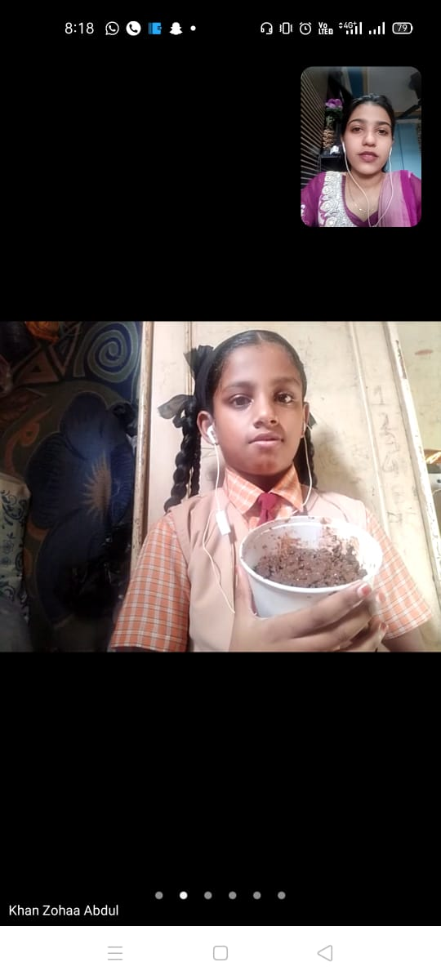
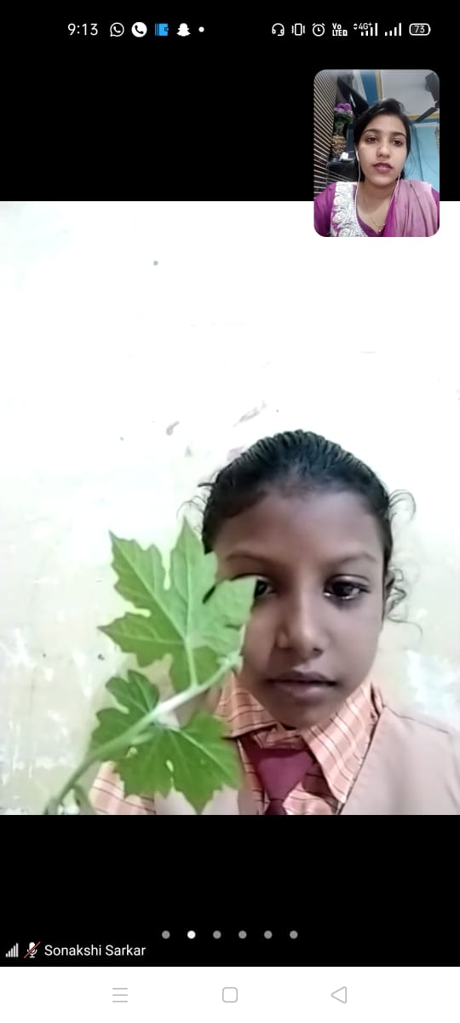
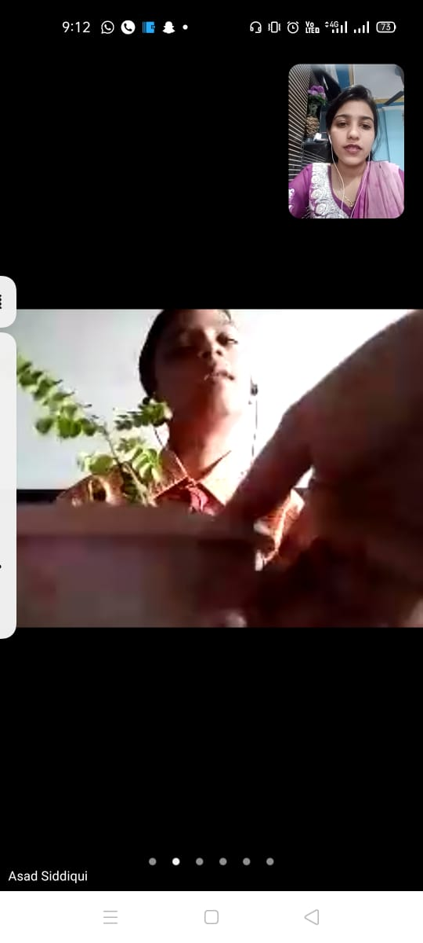
TREE PLANTATION ONLINE ACTIVITY

Slide 9
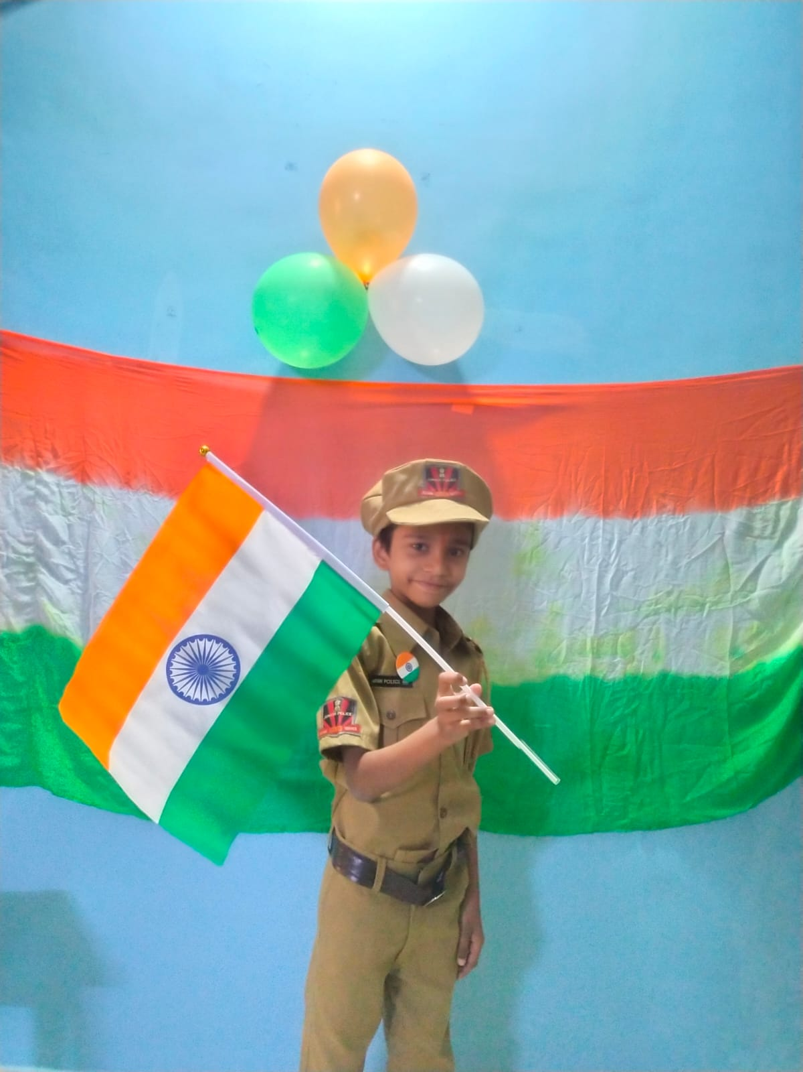
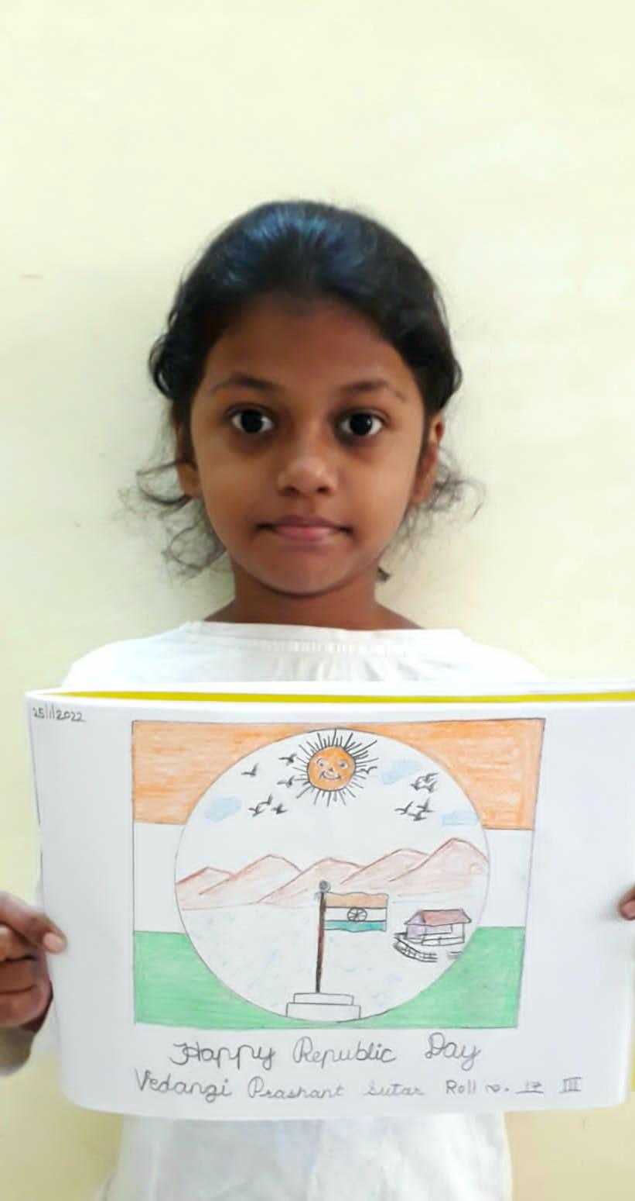
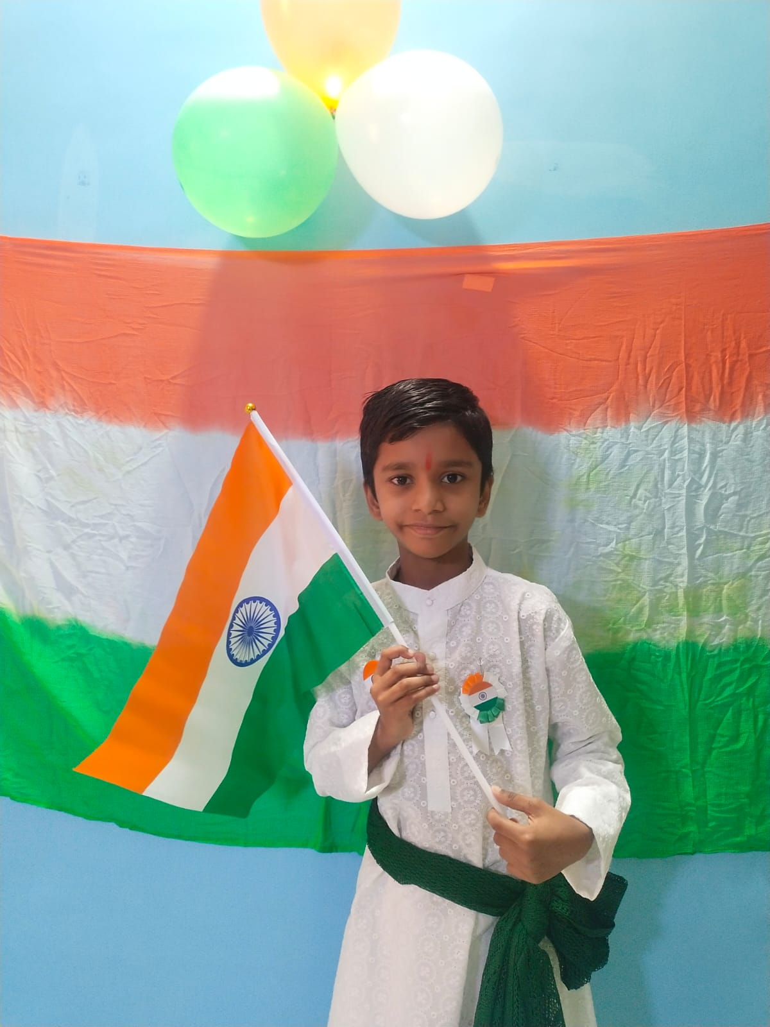
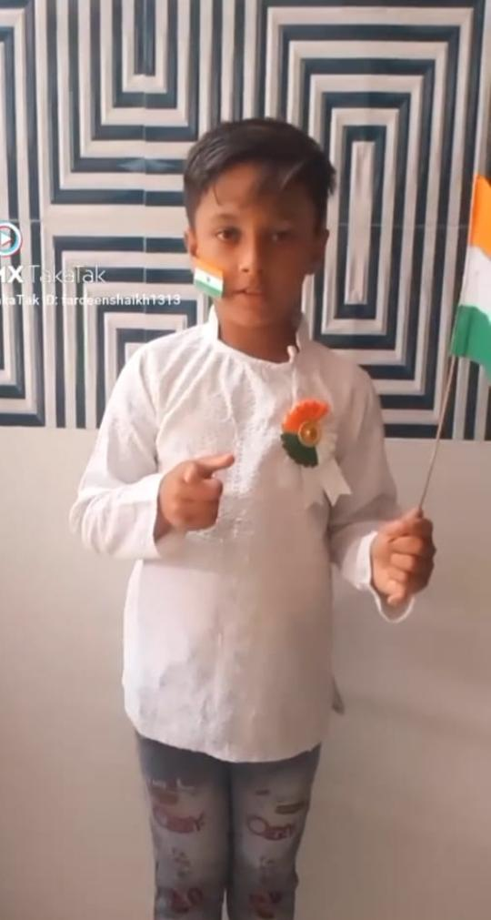
REPUBLIC DAY

Slide 10
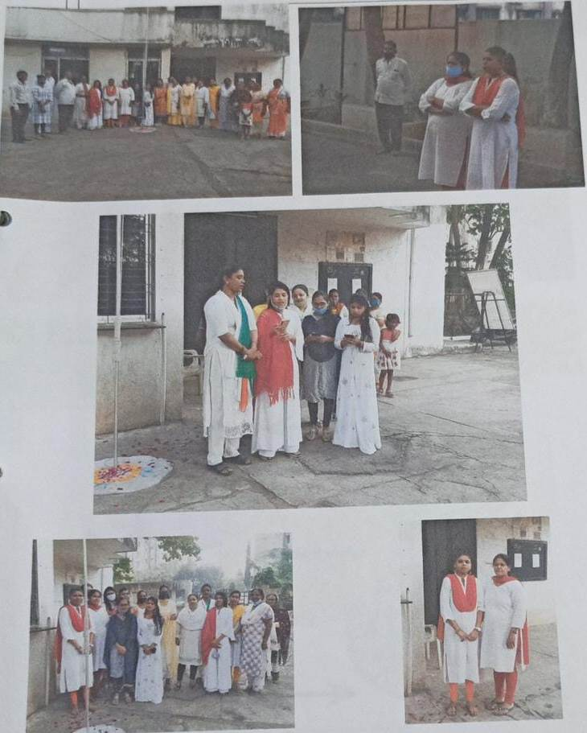

Slide 11
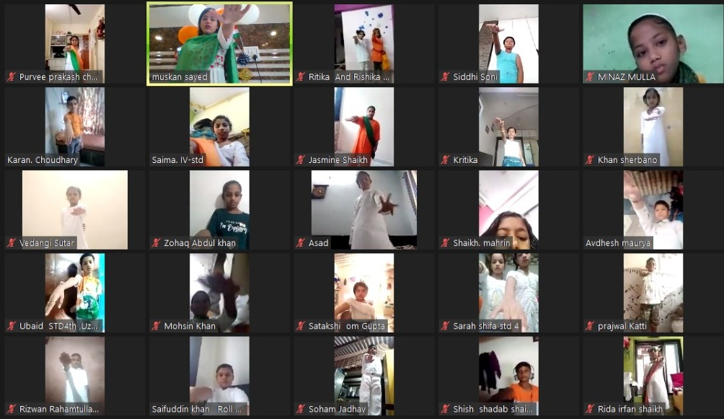
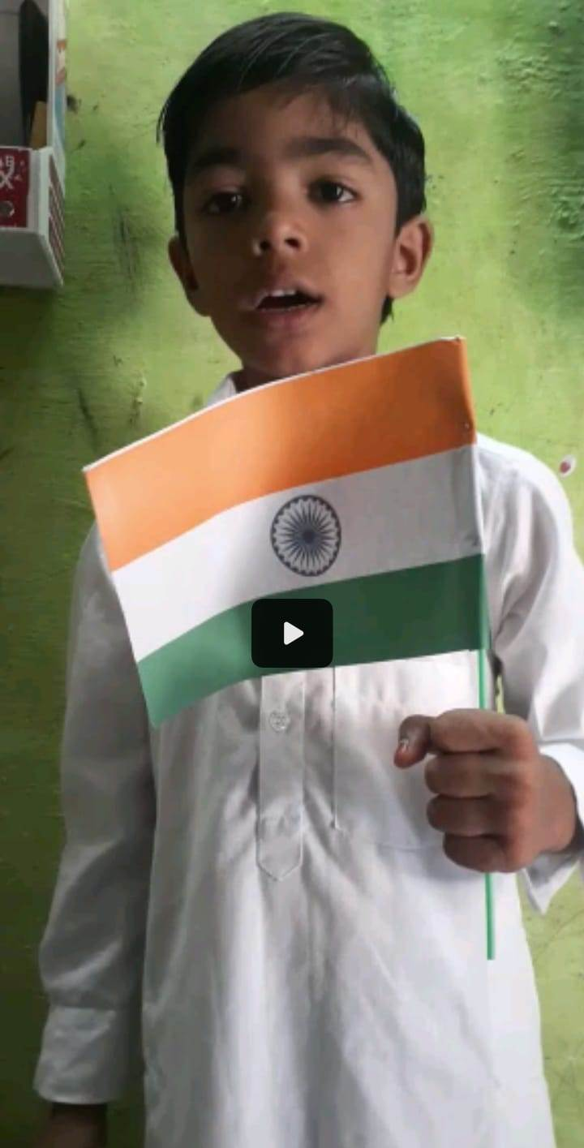
INDEPENDENCE DAY

Slide 12
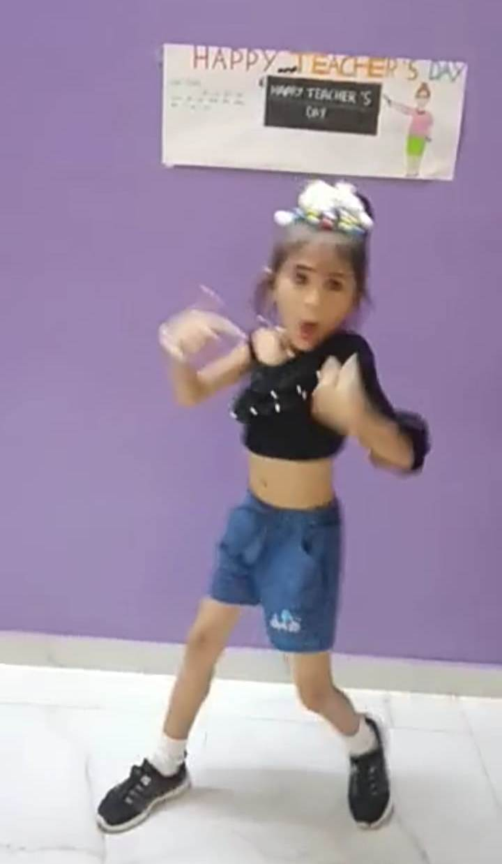
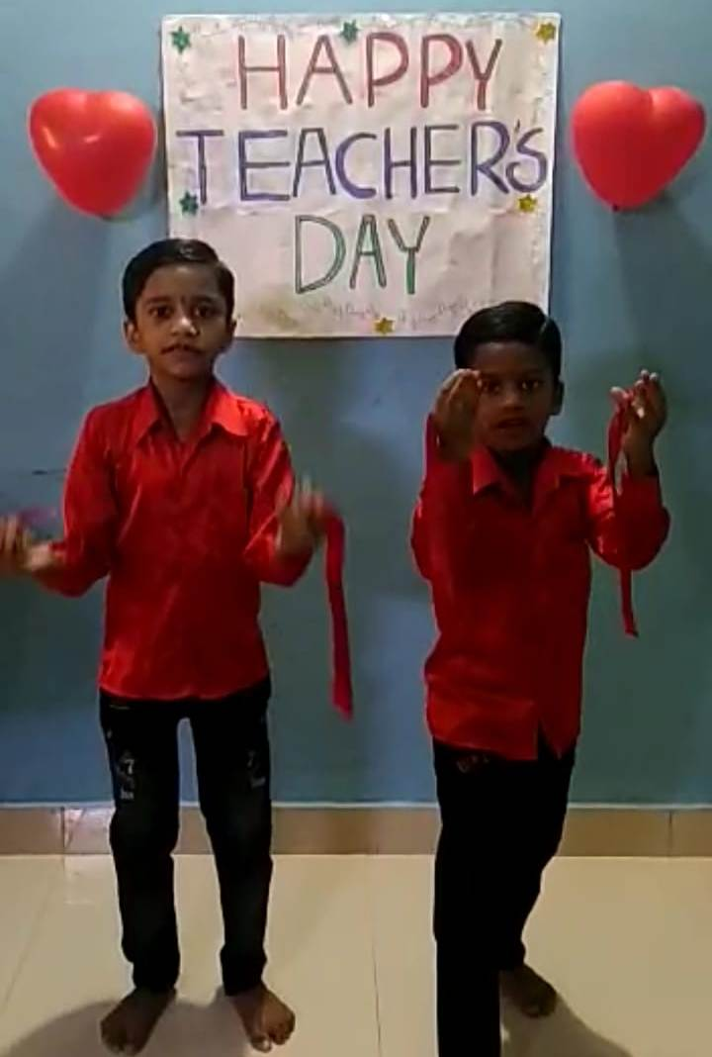
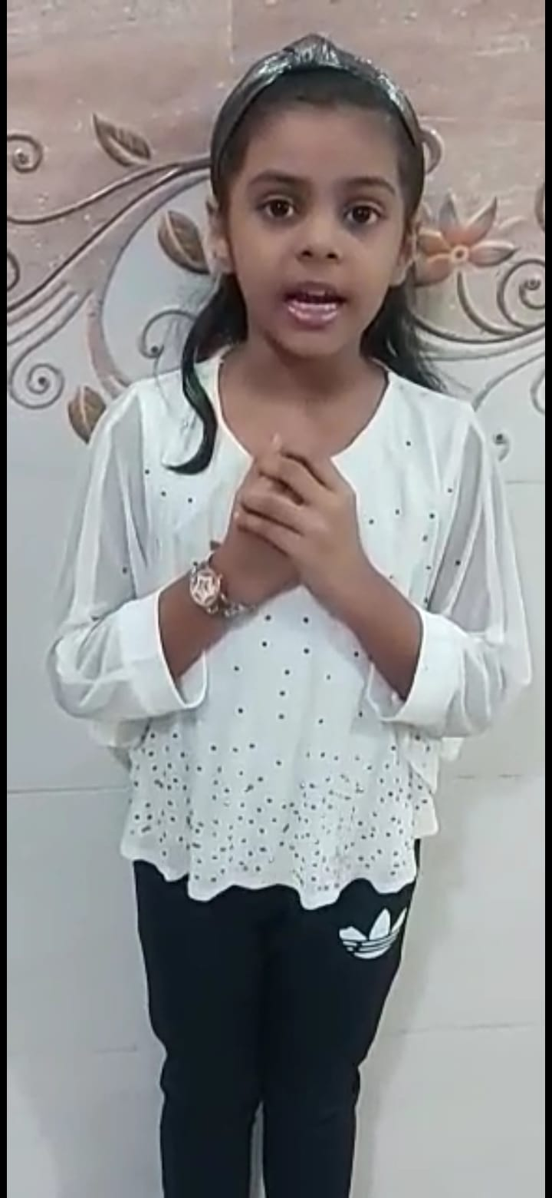

TEACHER’S DAY CELEBRATION ONLINE CELEBRATION

Slide 13
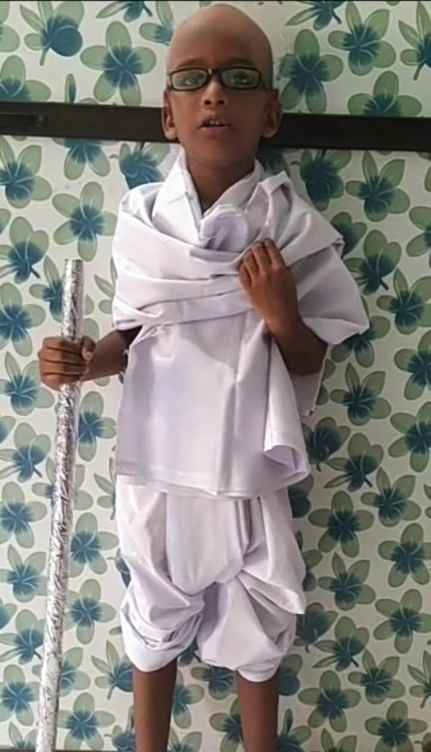
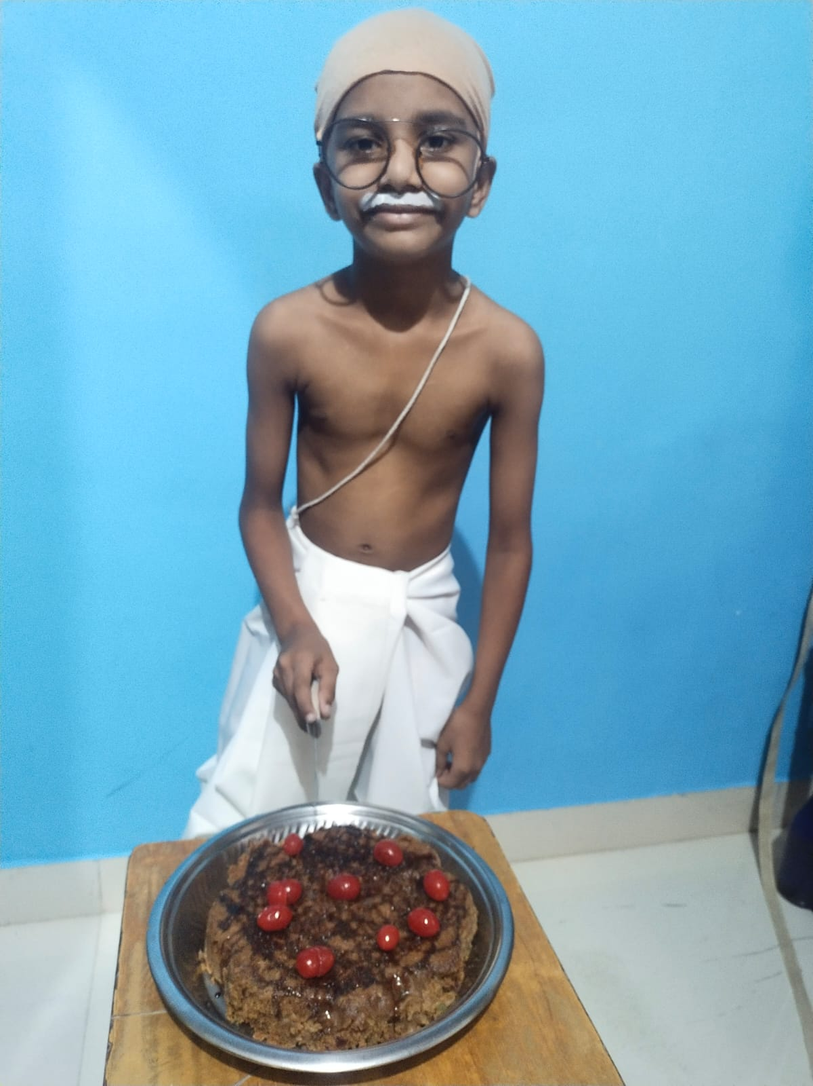
GANDHI JAYANTI CELEBRATION

Slide 14
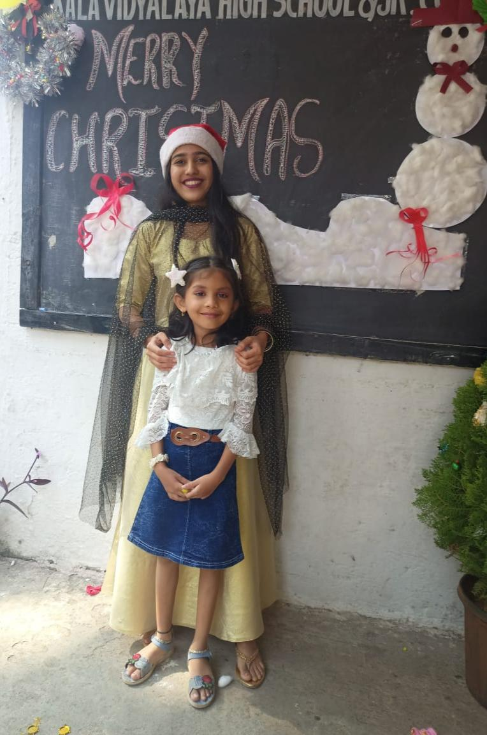
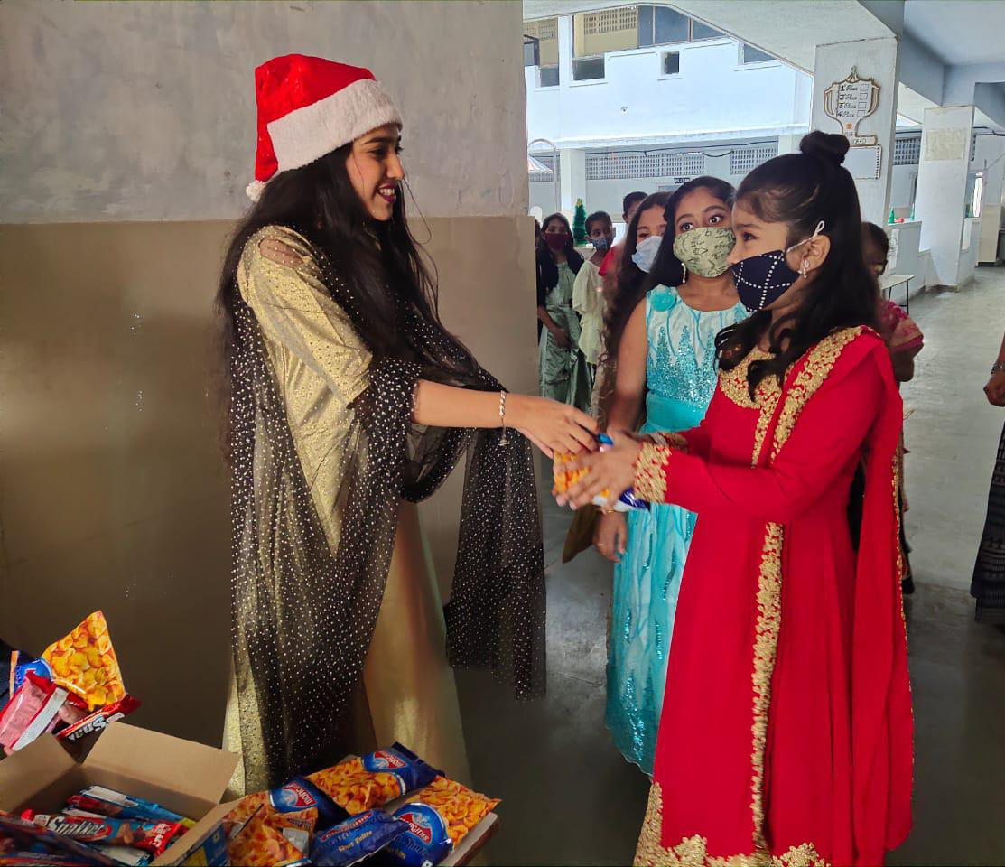
CHRISTMAS CELEBRATION

Slide 15
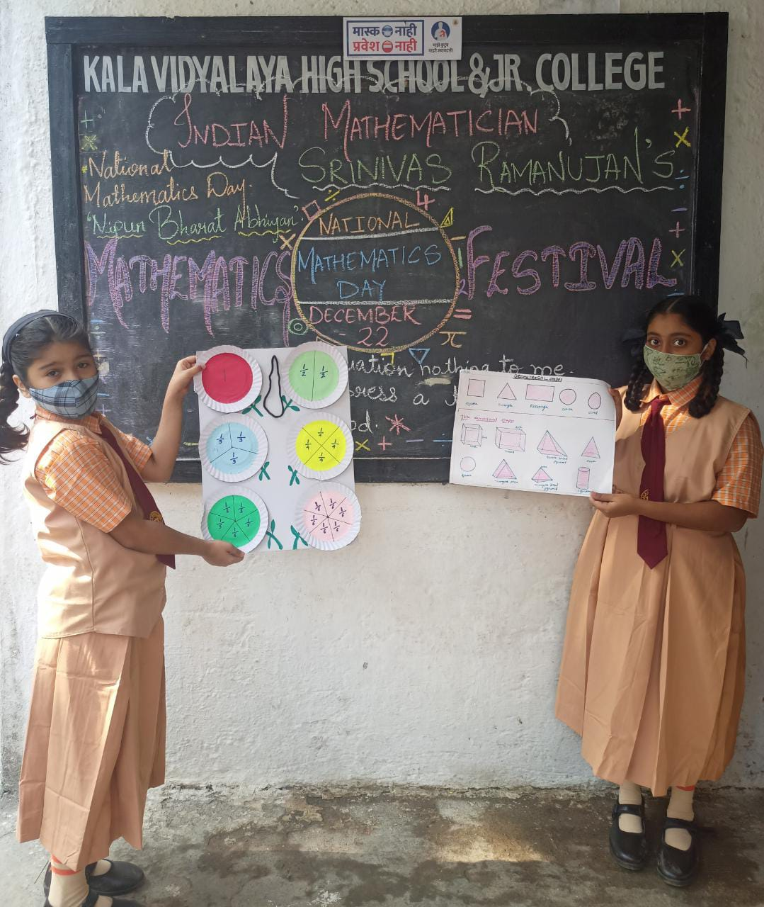
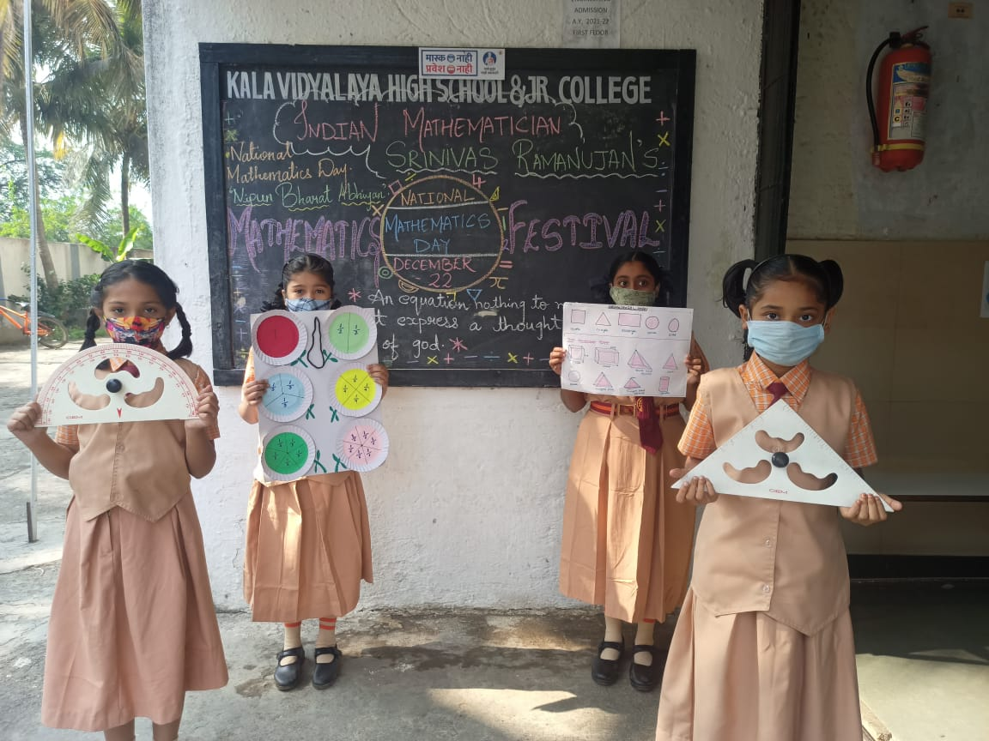
MATHEMATICS FESTIVAL.

Slide 16
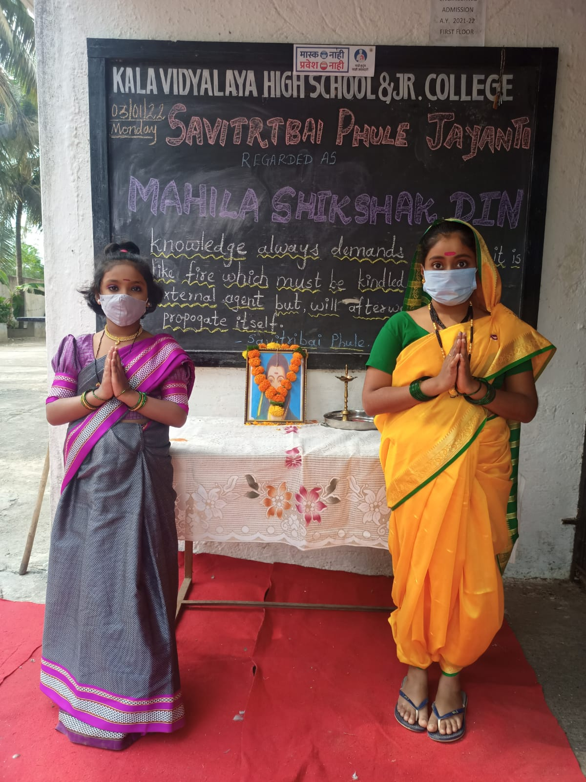
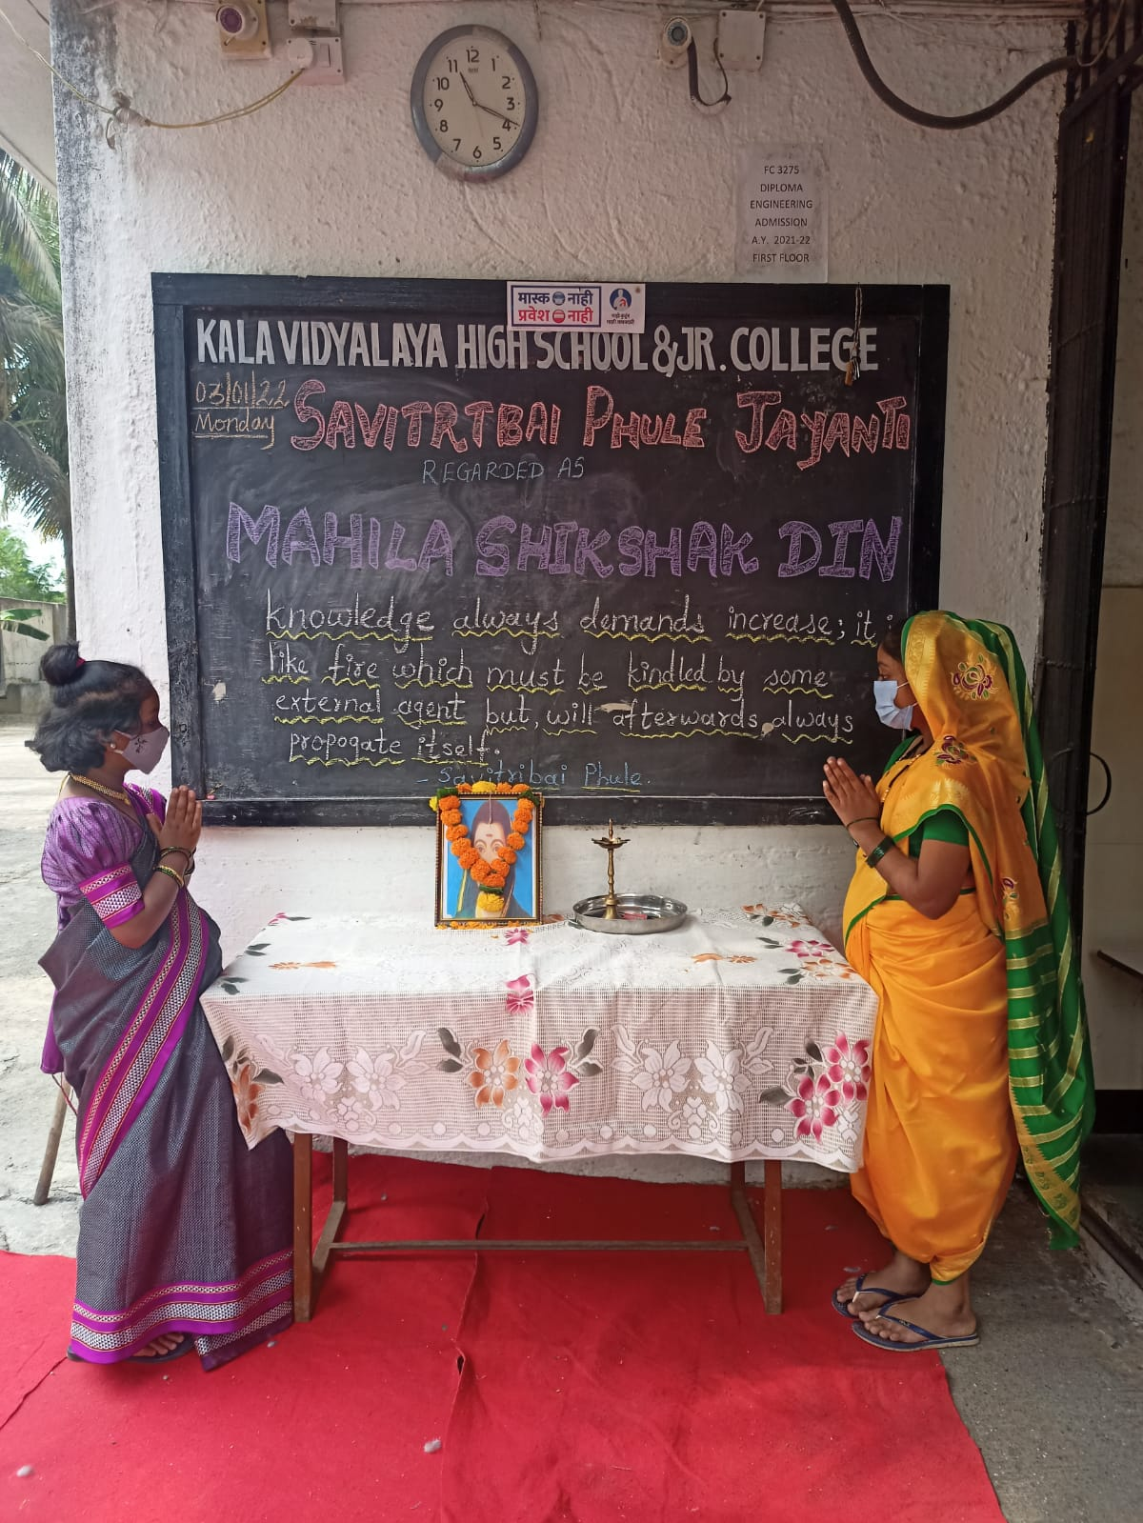
SAVITRIBAI PHULE JAYANTI.

Slide 17
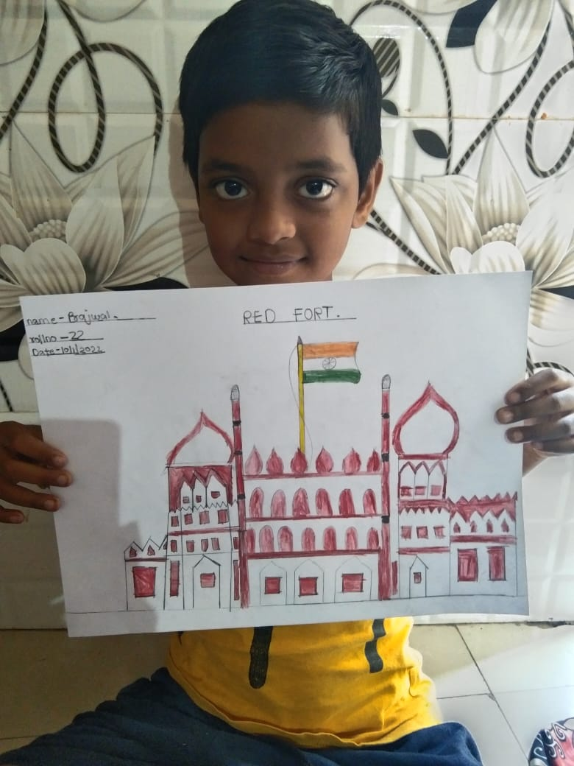
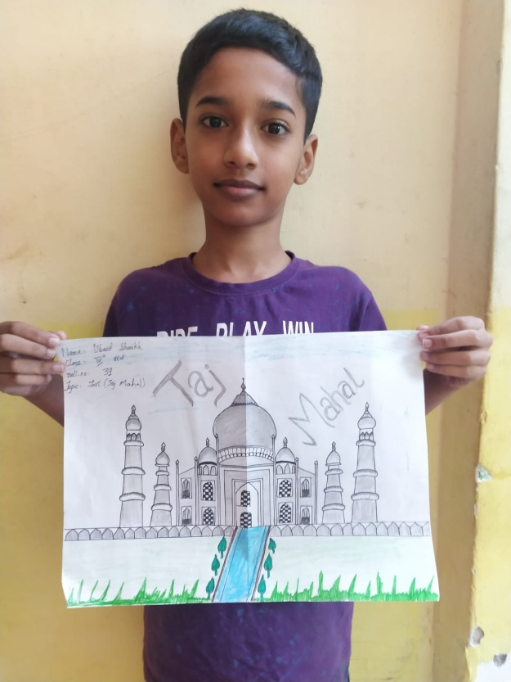
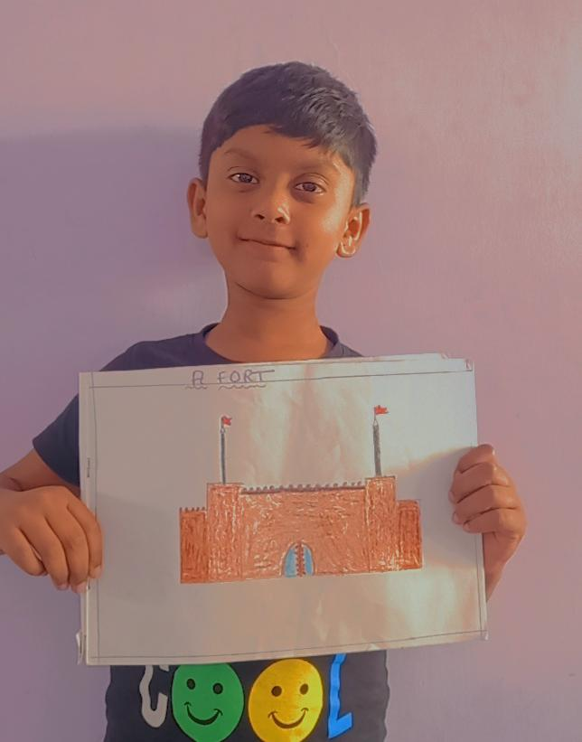
EK BHARAT SHRESHTHA BHARAT.

Slide 18
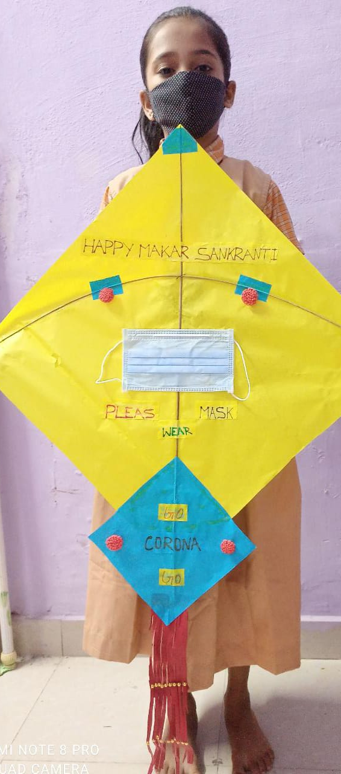
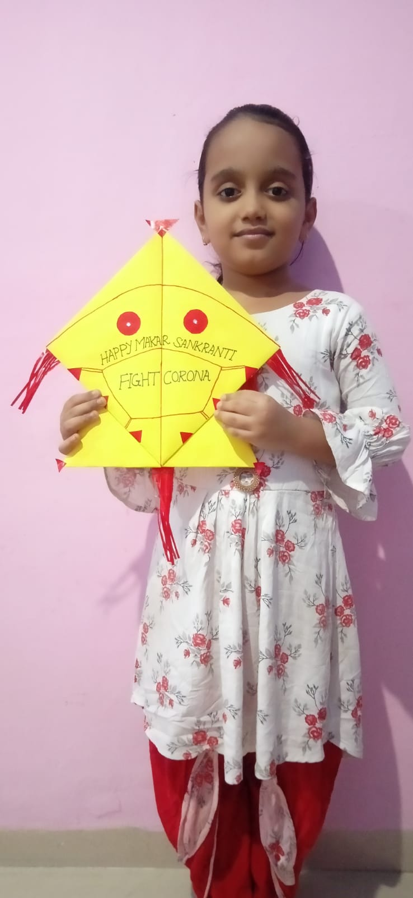
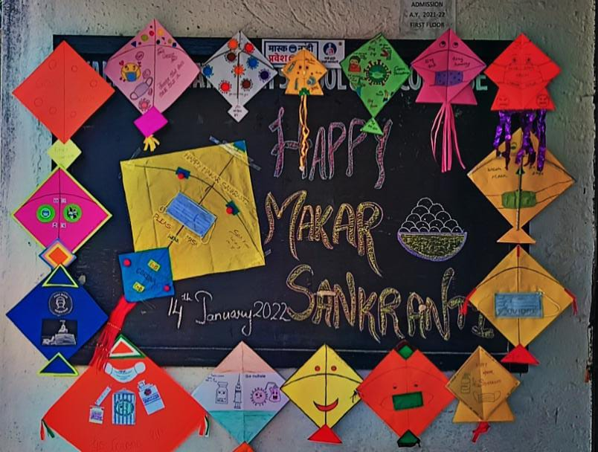
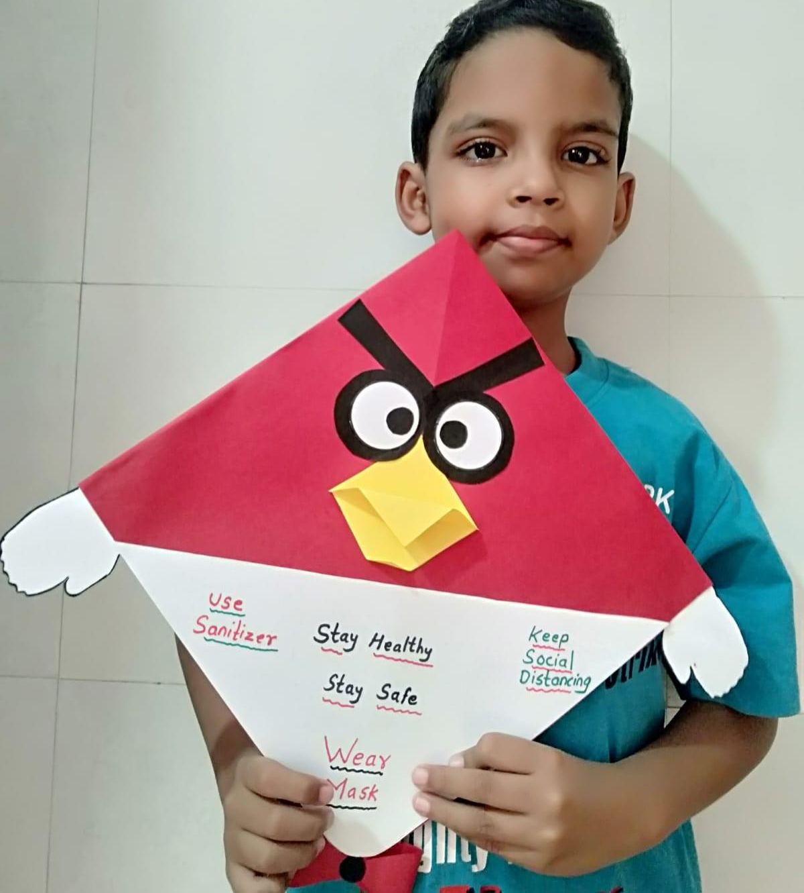
MAKARSANKRANTI

Slide 19
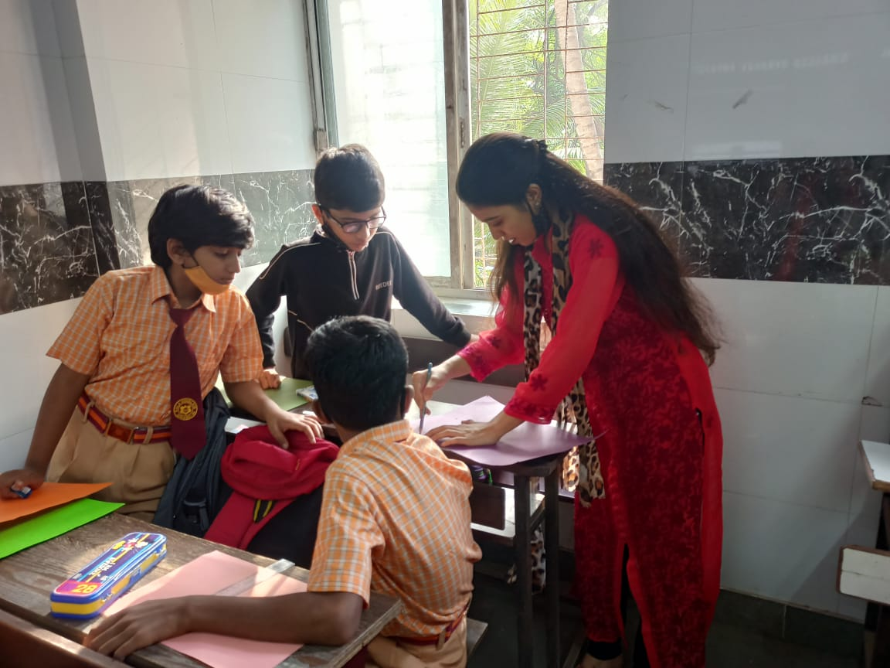
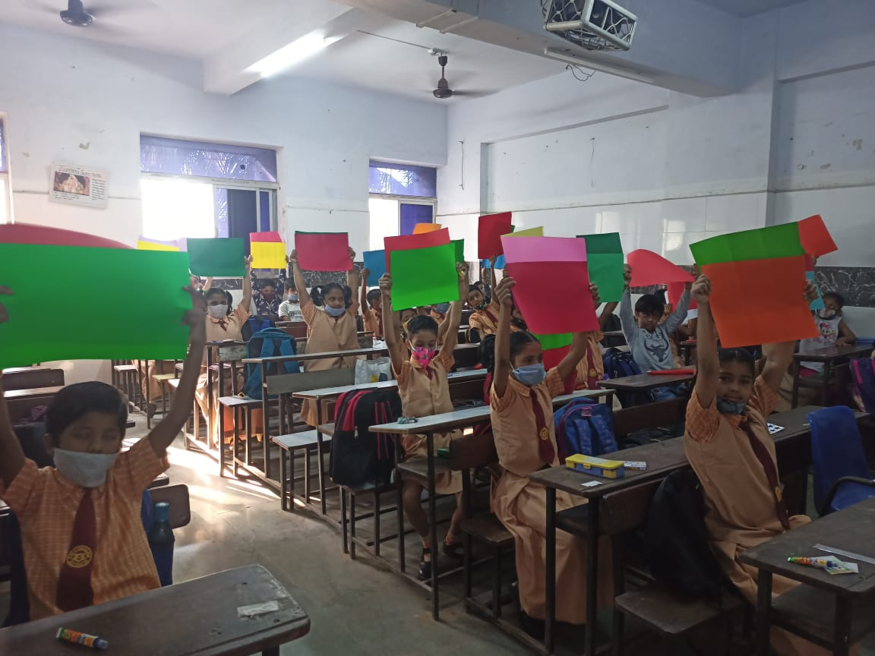
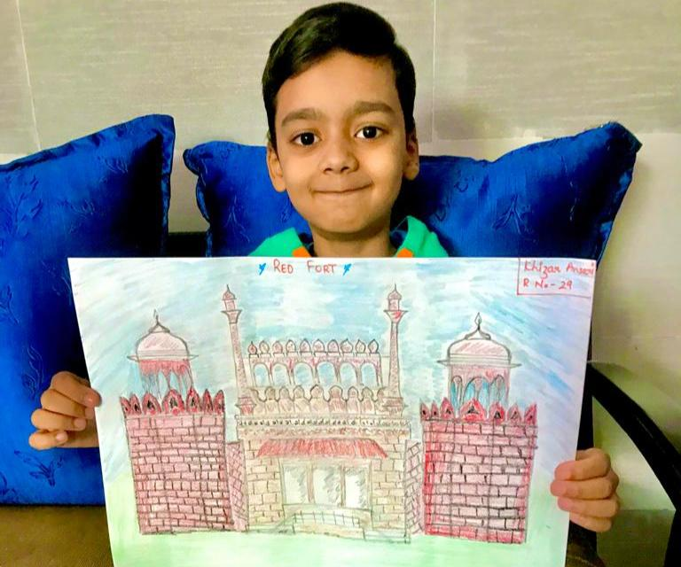
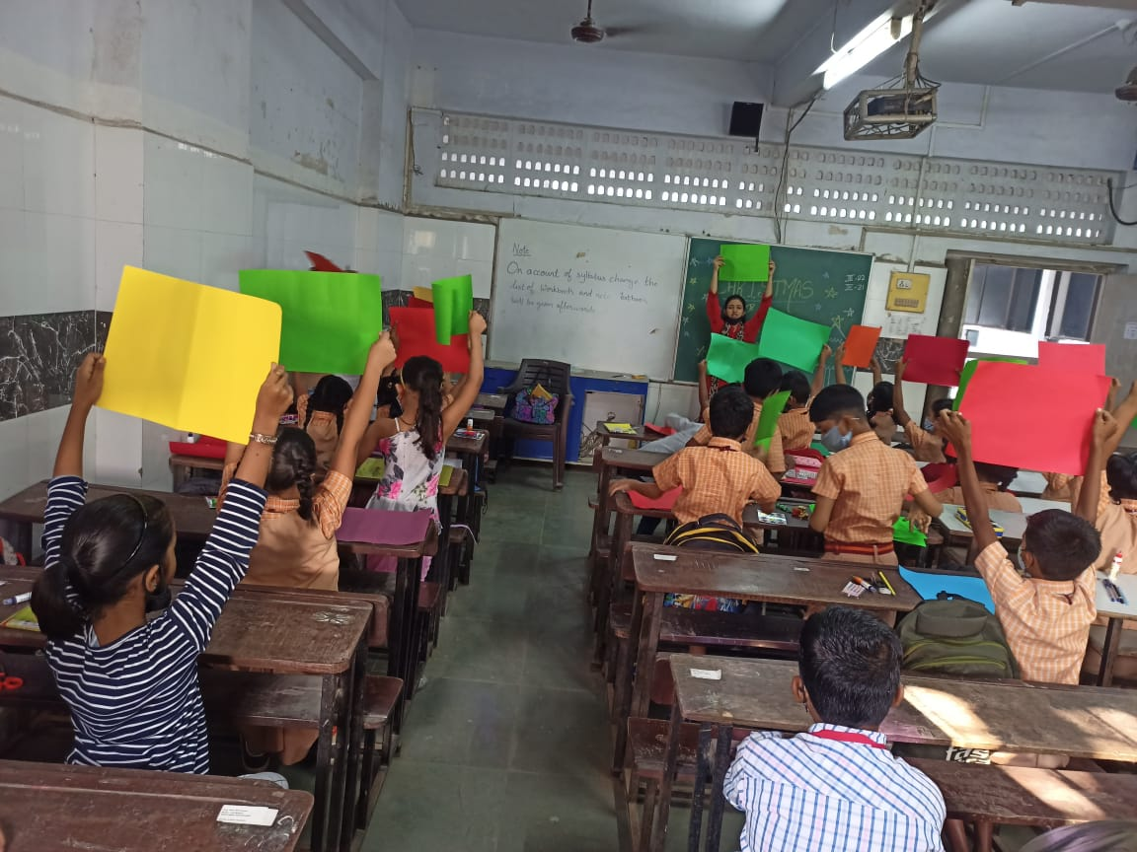
ARTS

Slide 20
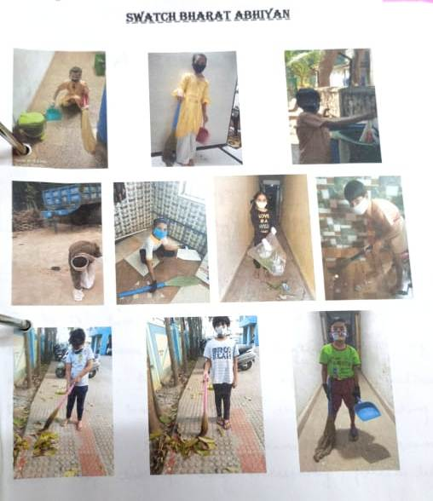
SAWATCH BHARAT ABHIYAN

